Slide 1
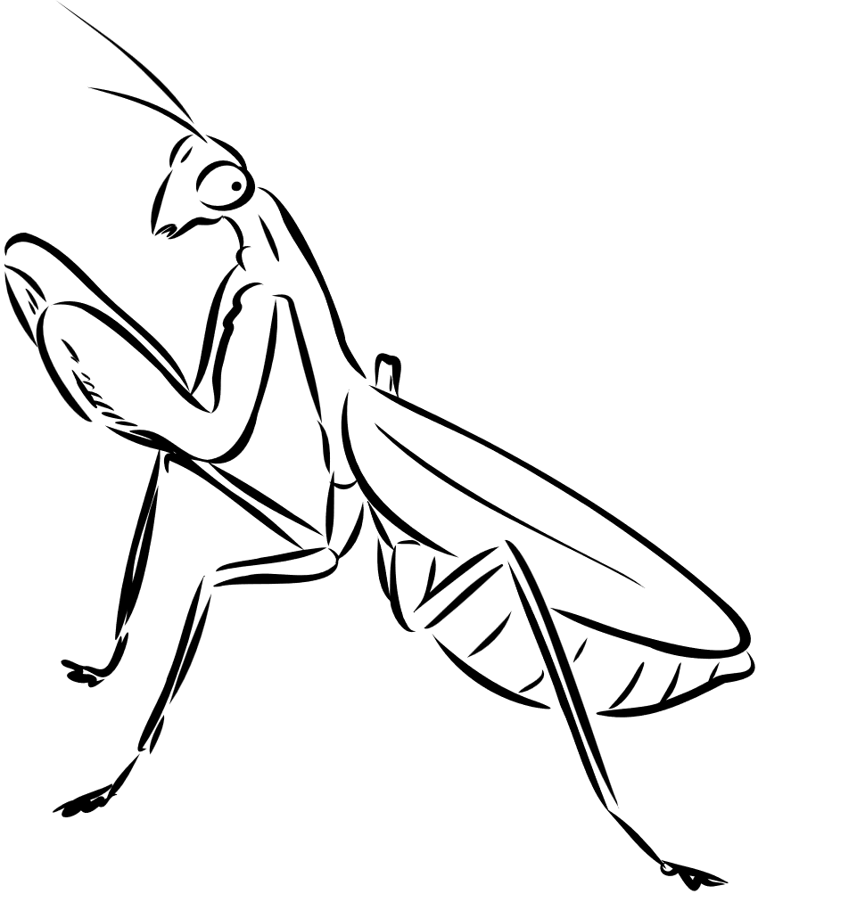
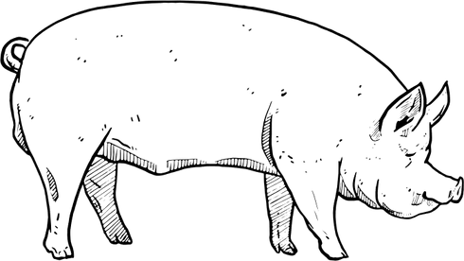
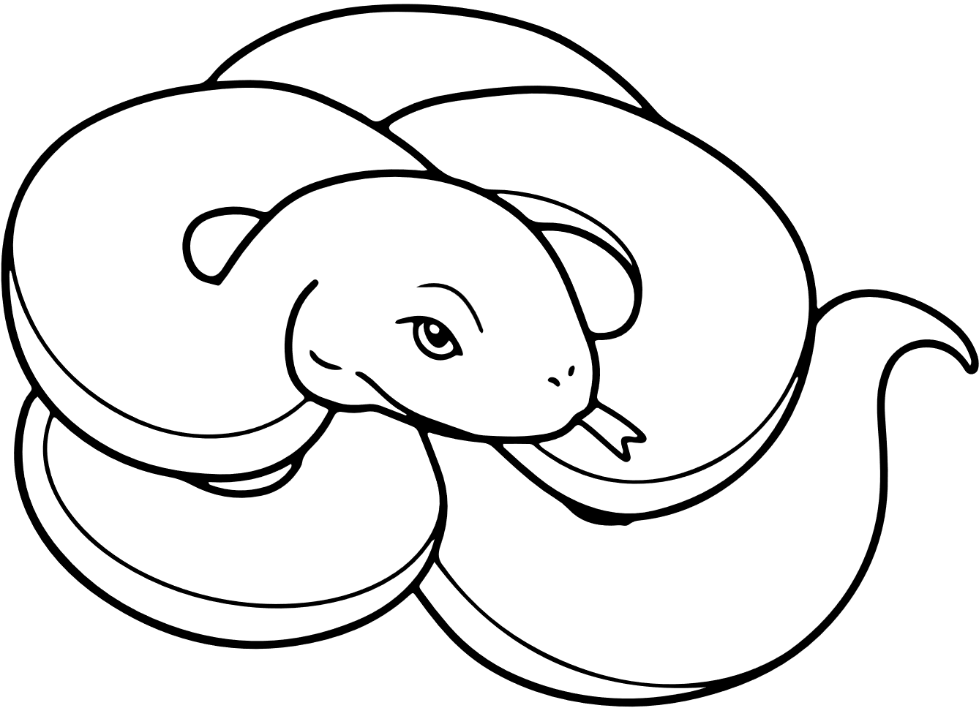

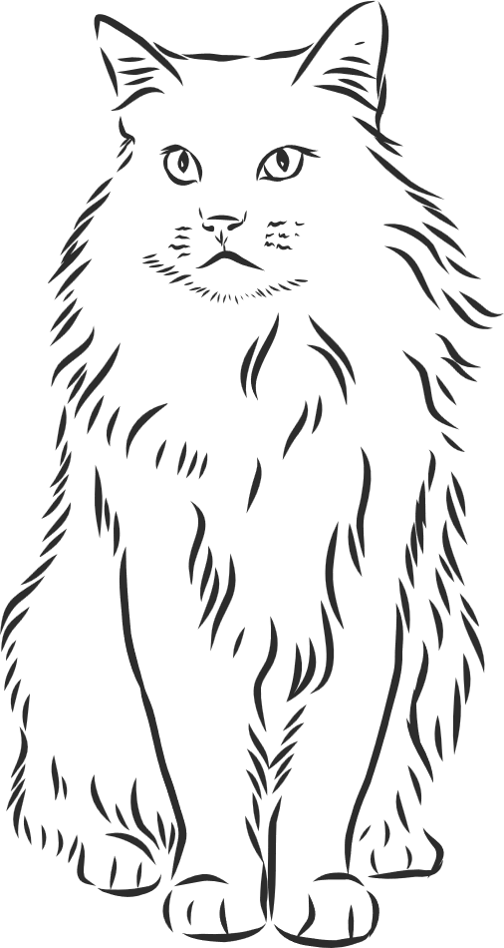
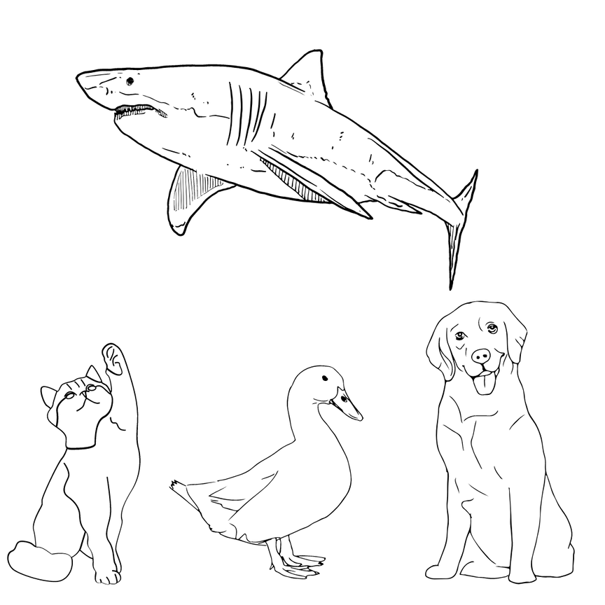

Animal Stereotypes
Are animals with a bad reputation just misunderstood?

Slide 2


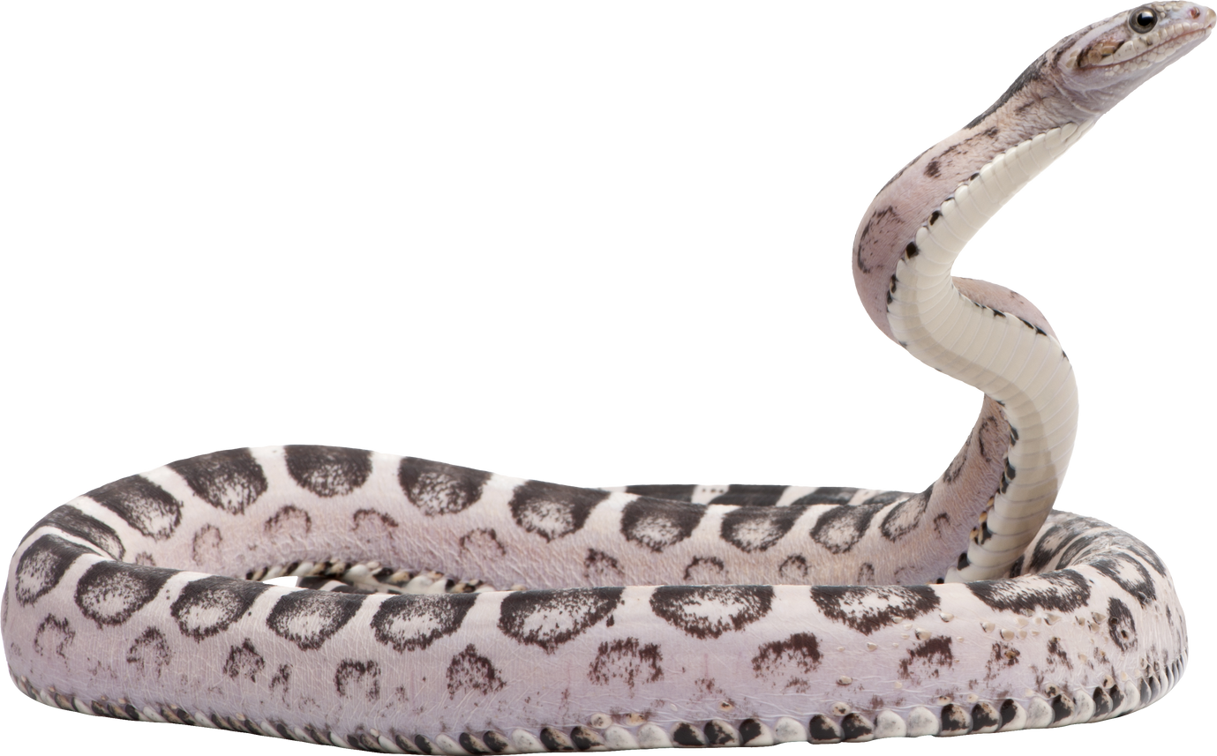
lesson Goals
Describe what a stereotype is
List some common animal stereotypes
Explain how animal stereotypes can be unfair or misleading
Notes:
By the end of this lesson, you should be able to:

Slide 3


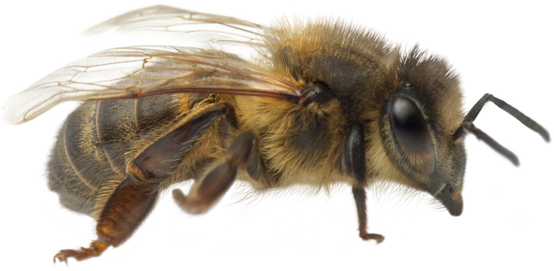
What is a stereotype?
Stereotyping is when people have a belief based on how someone looks, where they are from or what they like.
People think I’m busy all the time
Notes:
First read: We all have thoughts, ideas and images that pop into our heads when we are asked to think about something.

Slide 4

Animal stereotype
game
Based off the following stereotypes, what is the animal that comes to your mind?

Slide 5





Animal #1
I am also mysterious and magical
I am wise and intelligent

Slide 6
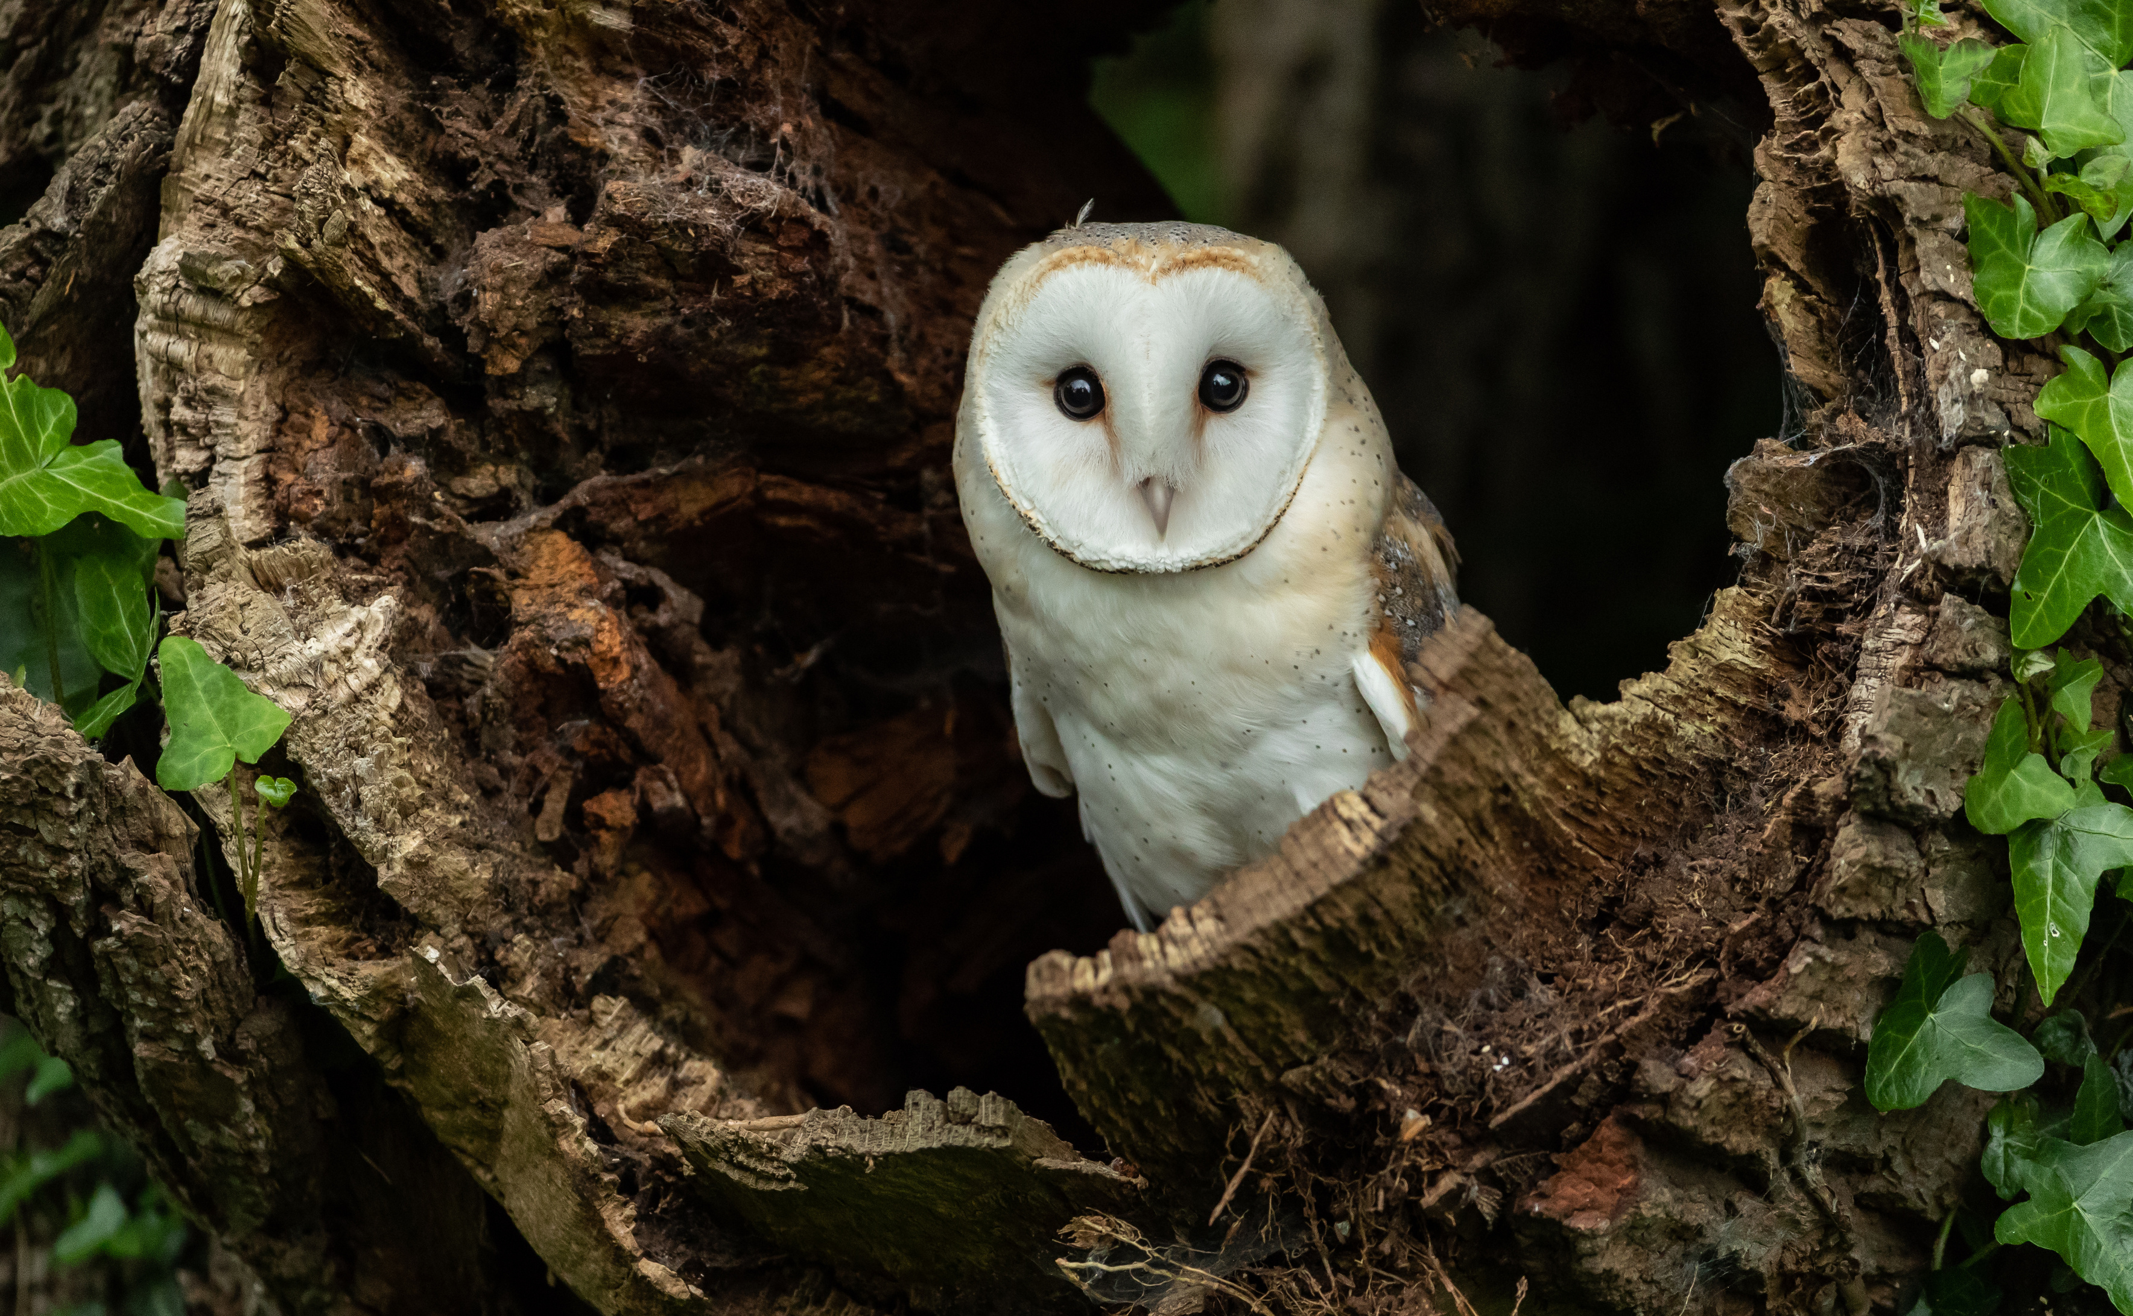
an owl
I am also mysterious and magical
I am wise and intelligent

Slide 7
Animal #2
I am creepy and crawly
I am very deadly if I bite you

Slide 8
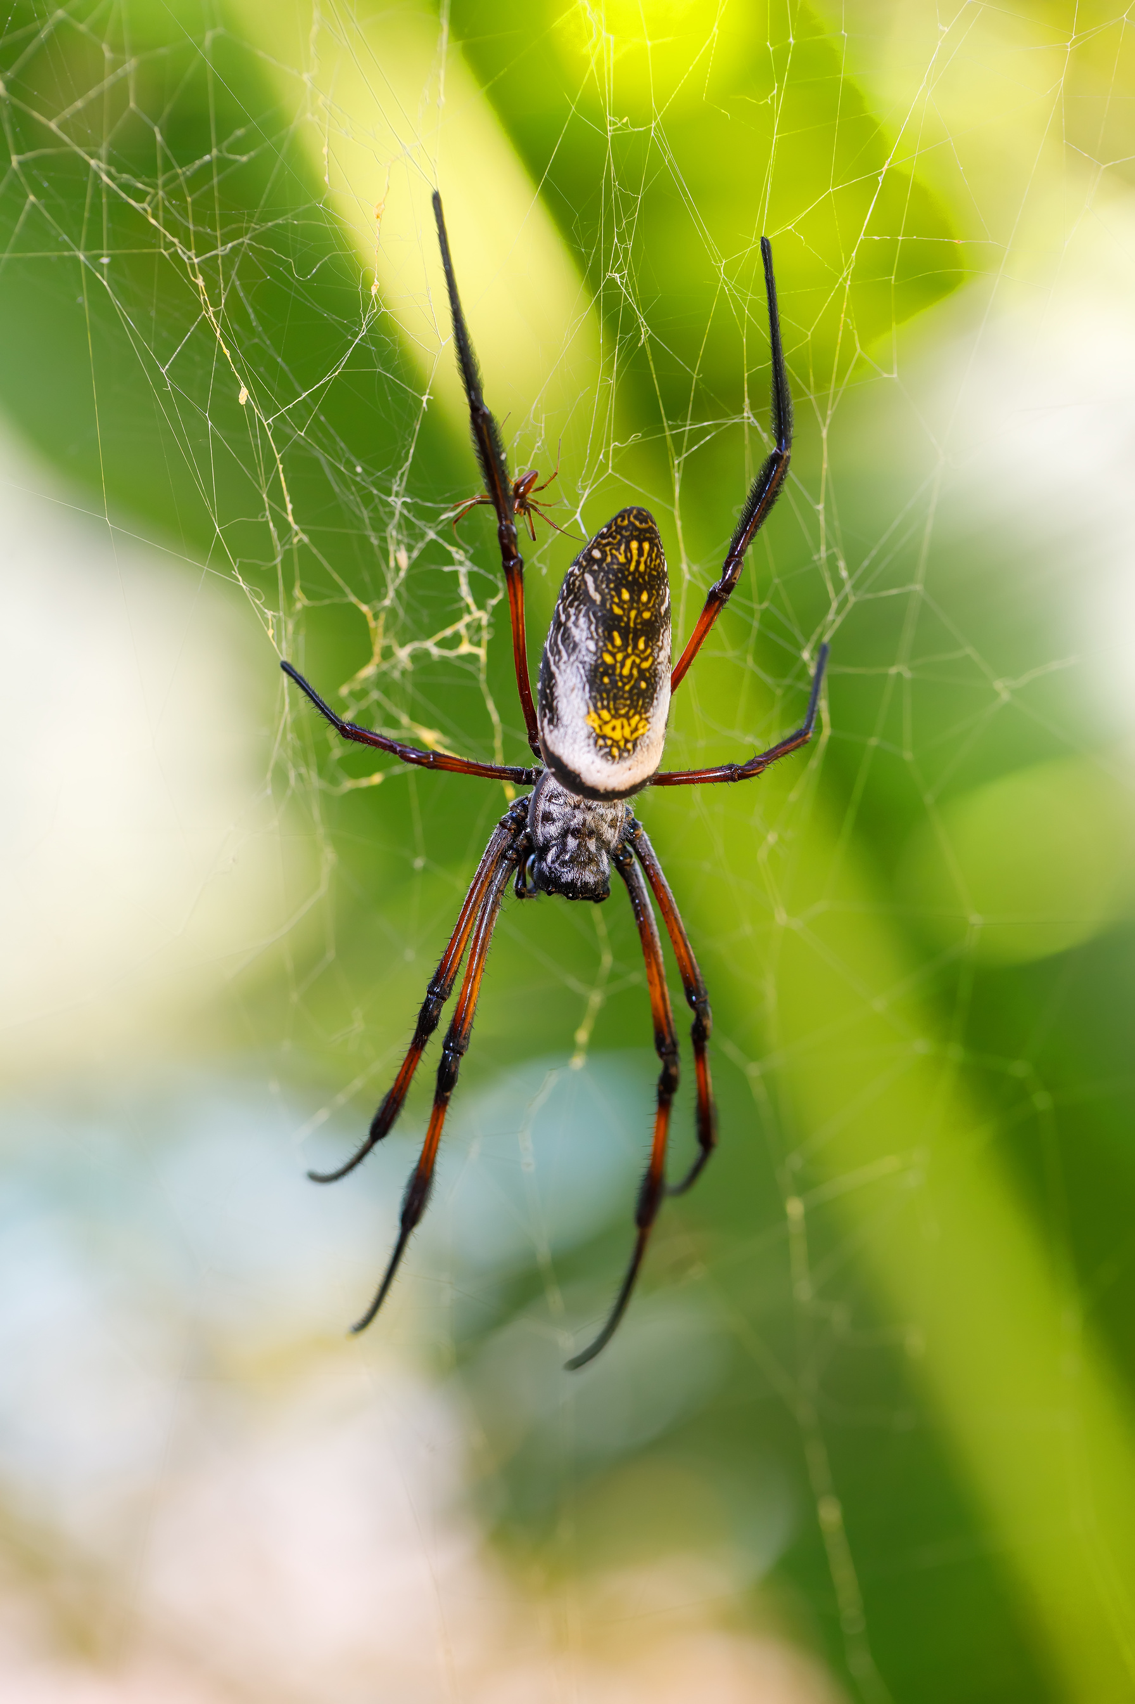
A spider
I am creepy and crawly
I am very deadly if I bite you

Slide 9
Animal #3
I do not have feelings
I have a 2 second memory

Slide 10
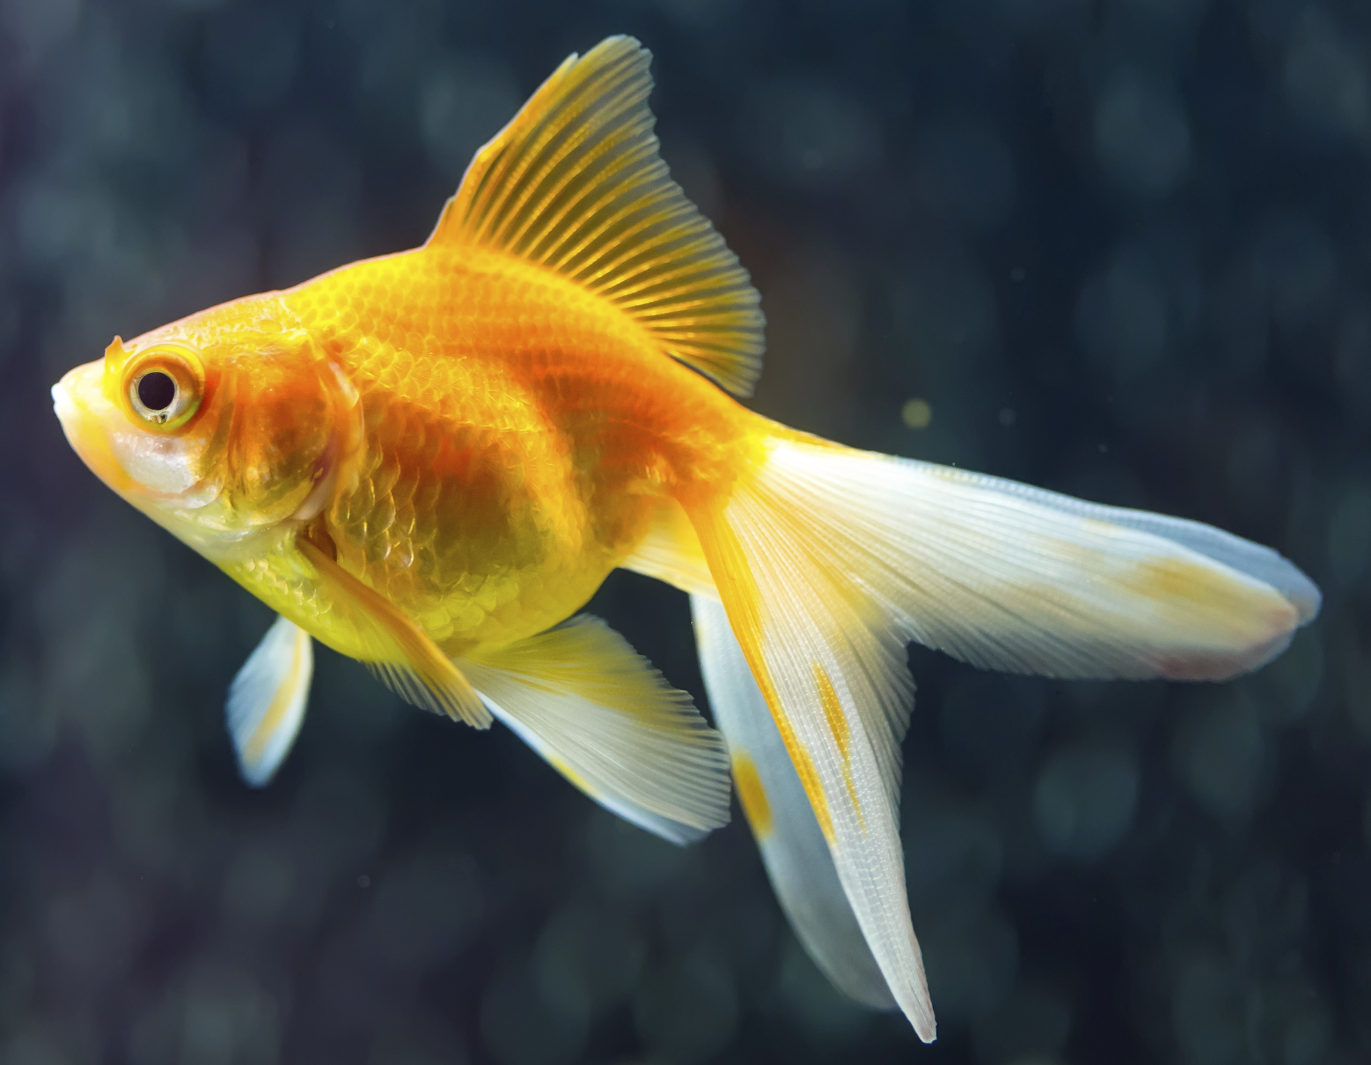
A Goldfish
I have a 2 second memory
I do not have feelings

Slide 11
Animal #4
I have a great memory
I am a slow moving gentle giant

Slide 12
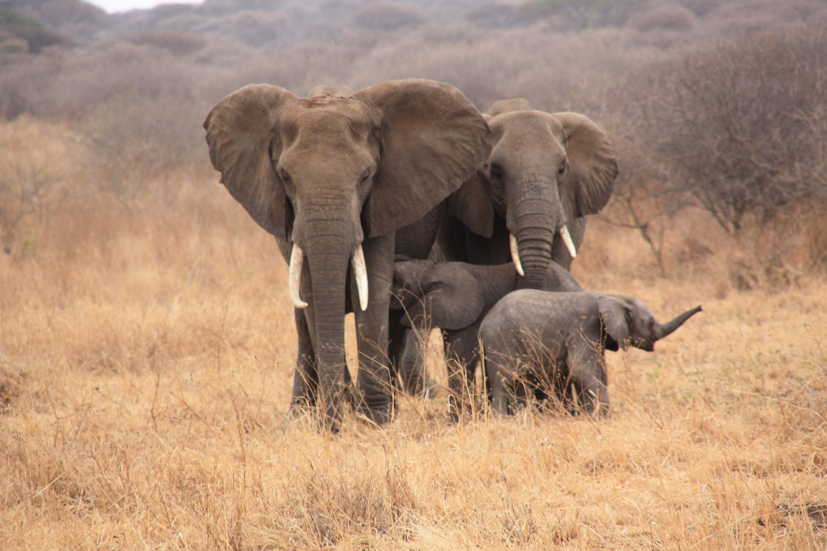
an elephant
I have a great memory
I am a slow-moving gentle giant

Slide 13

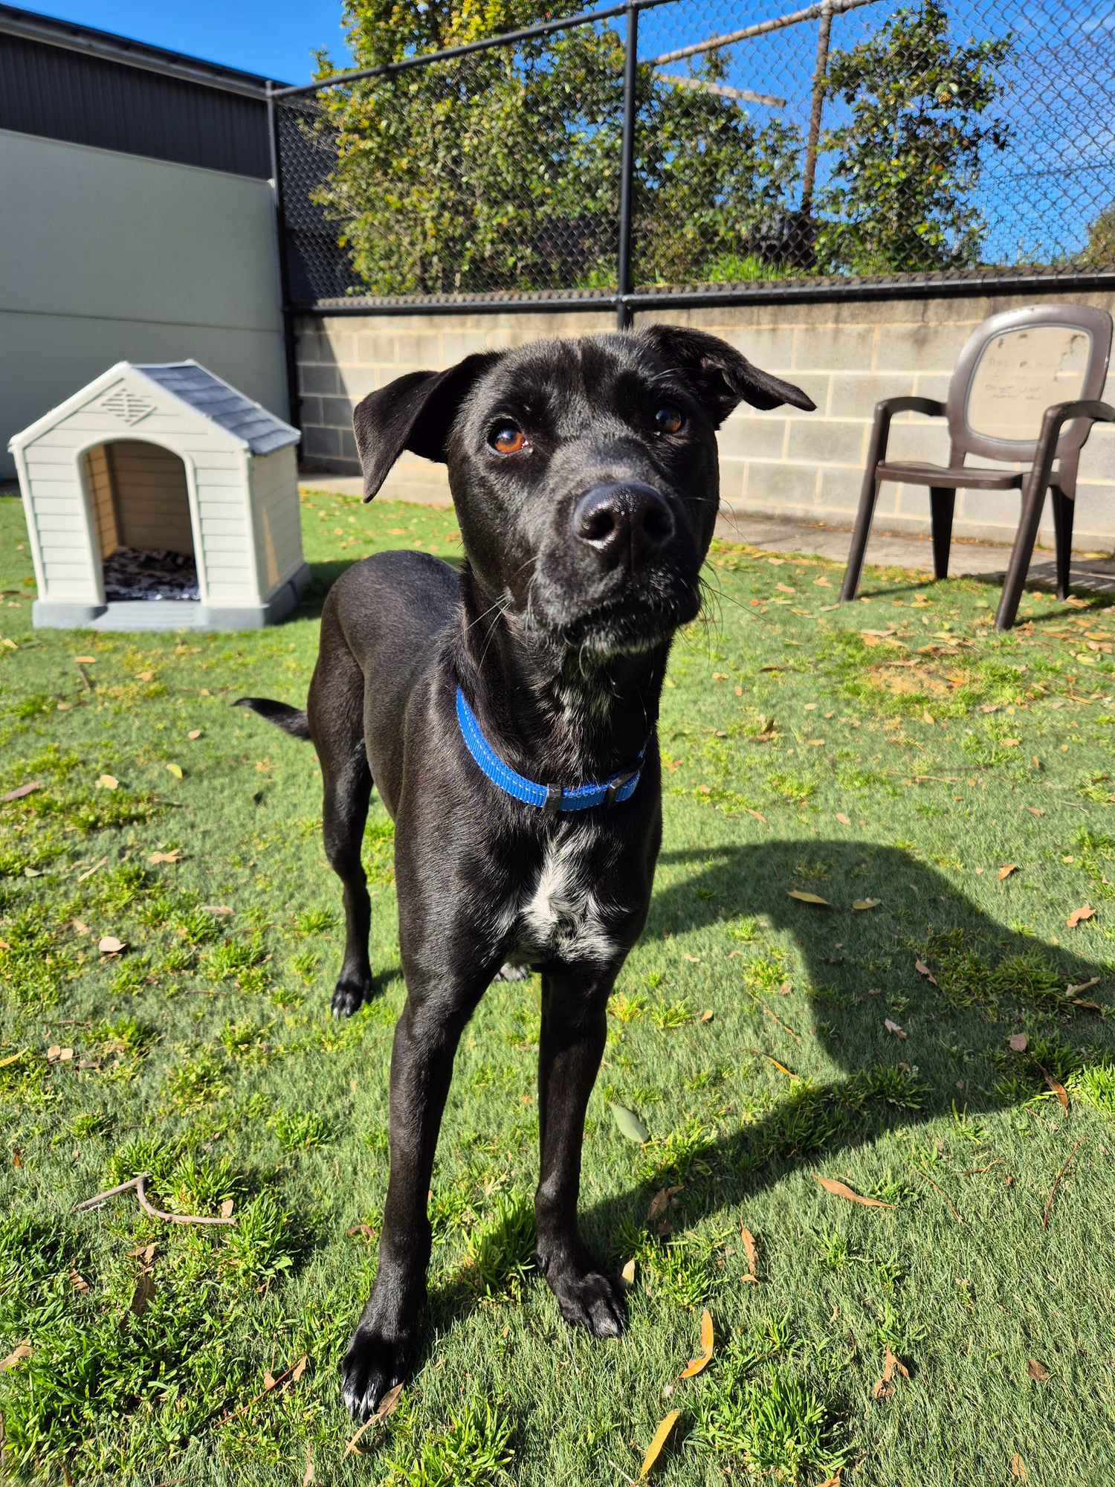

Animal stereotype
Stereotype: Black dogs are more aggressive and dangerous.
Fact: Black dogs are no more aggressive or dangerous than other coloured dogs.
With the right training and socialisation dogs of all colours and shapes can make great family pets!
Hi, I’m Squid!
Remember to always ask the owner if you want to pat their dog.

Slide 14
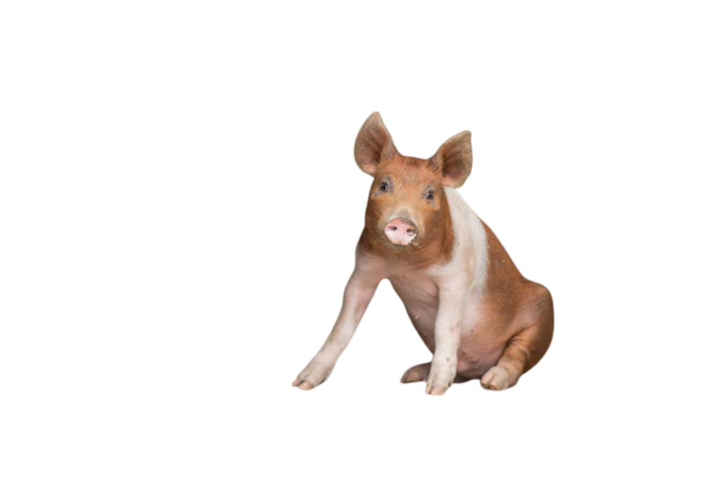
Be mindful
We need to be careful when using stereotypes because they aren’t always accurate especially the negative or hurtful ones!
Can you think of another example of a misleading stereotype?
​
I am very intelligent
Notes:
We are exposed to many different messages about animals from movies, the news and stories. These all shape our understanding and the way we think about different animals. BUT we need to be careful when using stereotypes because they aren’t always accurate especially the negative or hurtful ones!
Activity: With a partner, have students think of another example of a misleading stereotype. Have a few students share their examples with the class.
If appropriate, could ask students, ‘has there been a time when someone has used an incorrect or hurtful stereotype towards you? How did that make you feel? What do you wish that person understood about you?

Slide 15


Persuasive Writing Task
What is the purpose of a persuasive text?
To share your opinion and try to convince the reader to agree with you.

Slide 16
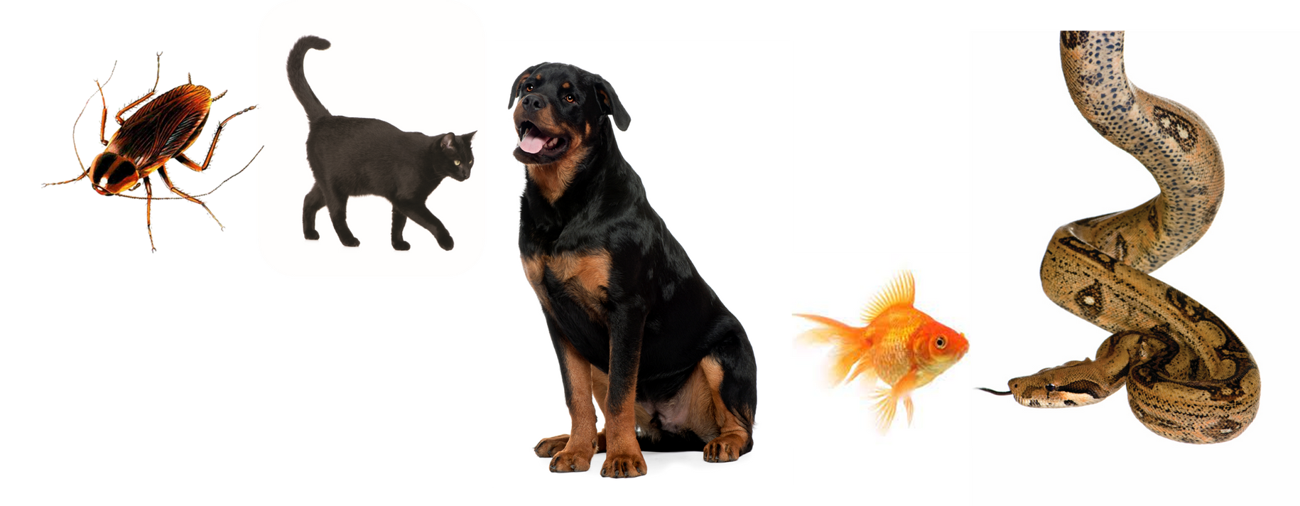
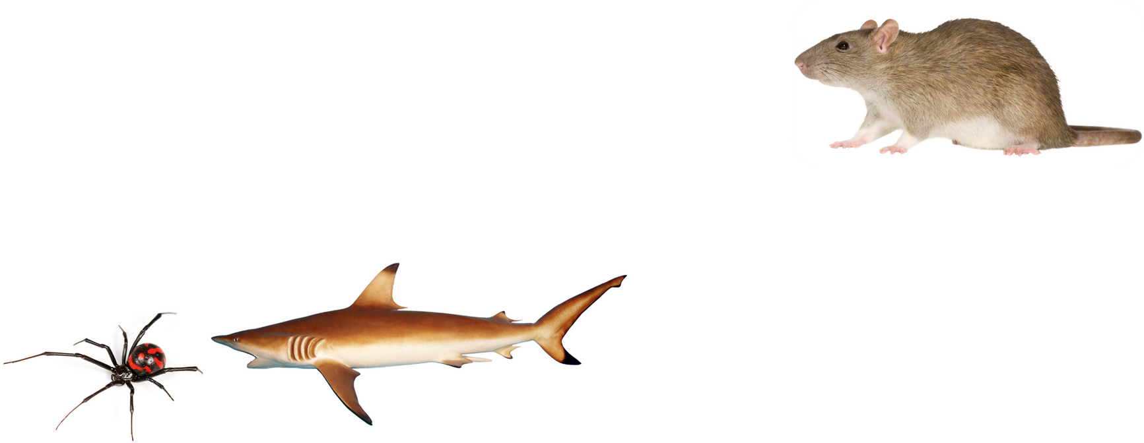
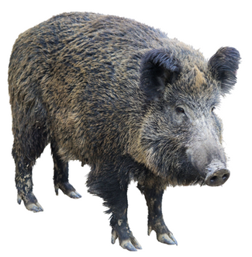
Step 1: choose an animal
Think about some of the stereotypes for your chosen animal.

Slide 17
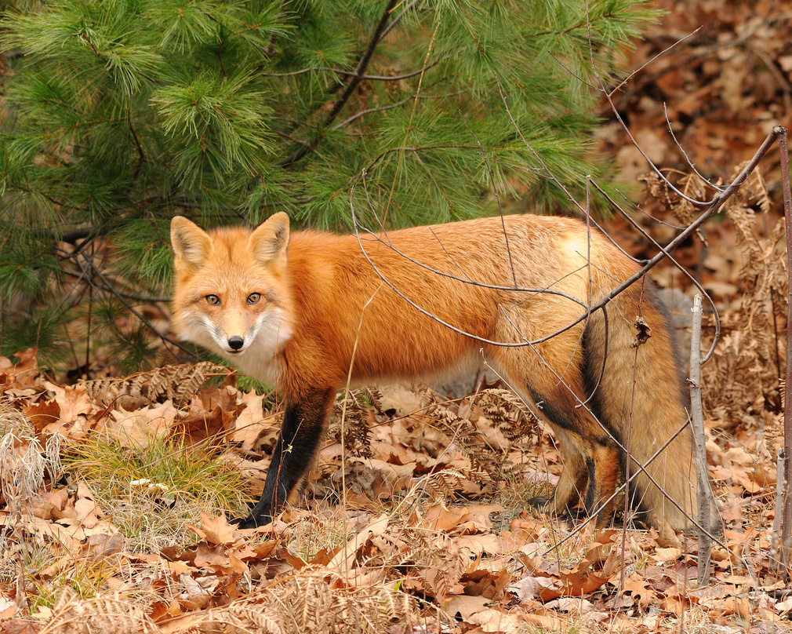


Step 2: Write a letter
From the point of view of your chosen animal, write a letter addressed to your class that describes the negative stereotypes that people commonly have about you.
sly
loner
cunning
mysterious

Slide 18



Step 3: make it persuasive
In your letter, argue whether you find these stereotypes fair or unfair. Write three reasons to support your opinion that will convince the reader that your opinion is valid.
Truth
Are all rats dirty?
STEREOTYPE

Slide 19


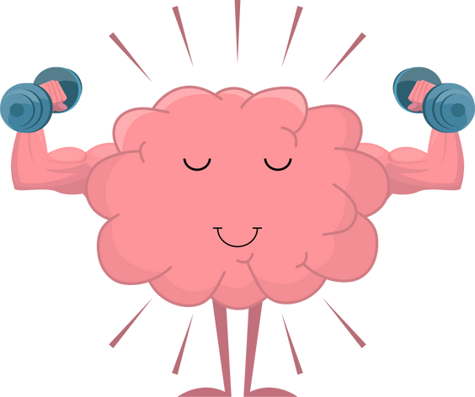
Example letter
Introduction
Dear Class 3M students,
My name is Eddie, and I am an eel.
Most people find me scary and slimy. Just like in the cartoons, people think that when they see me I will most definitely give them a painful electric shock!
I find these stereotypes unfair because really, I am shy and just enjoy hiding among the rocks in the ocean.
End by summarising your points and stating, once again, how you think your stereotypes are unfair or fair.
Stereotype
Extend yourself!
Include facts or example to support your opinion.
Supporting reason
Conclusion

Slide 20
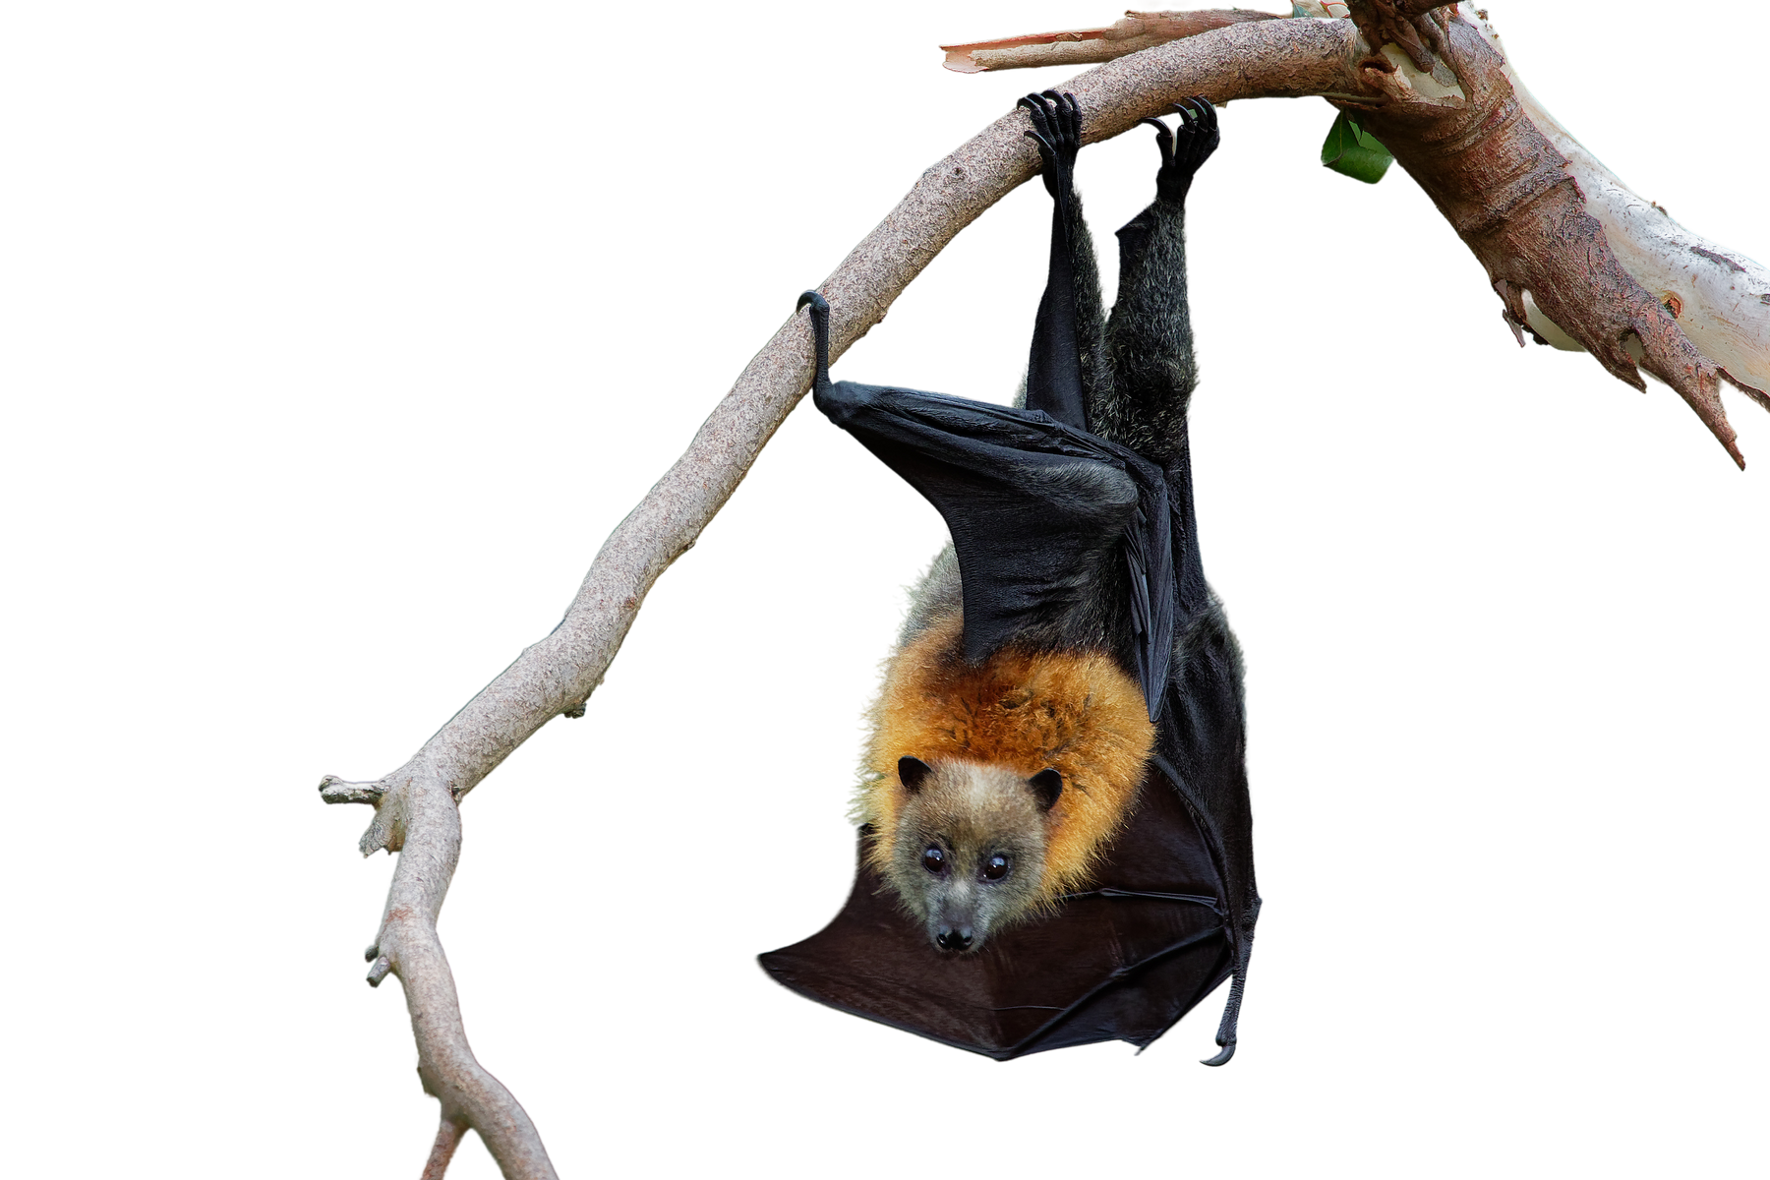
remember!
I don’t want to suck your blood
Stereotypes are not accurate descriptions of entire animal groups.
Stereotypes can cause people to overlook the unique qualities and characteristics of each animal and treat them unfairly.
It is important to treat all animals with respect and not make judgements based on stereotypes.

Slide 21









Useful descriptive words
loud
silly
scary
dangerous
aggressive
helpful
playful
simple
Intelligent
sweet
annoying
dirty
misunderstood
| 15

Slide 22
Useful descriptive words
strong
tough
slimy
simple
tough
fun
resilient
powerful
boring
wise
thoughtless
cheerful
quiet

Slide 23


Slide 24
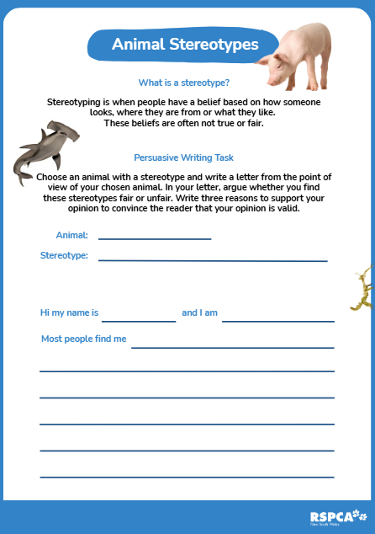
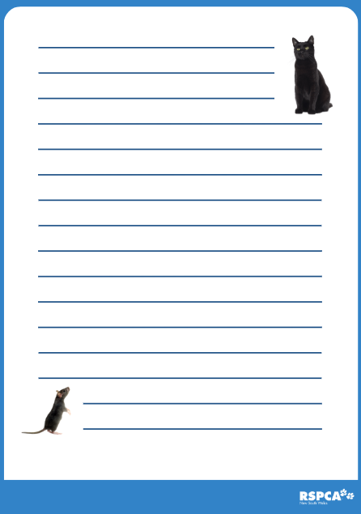
Lesson resources
worksheet

