Slide 1
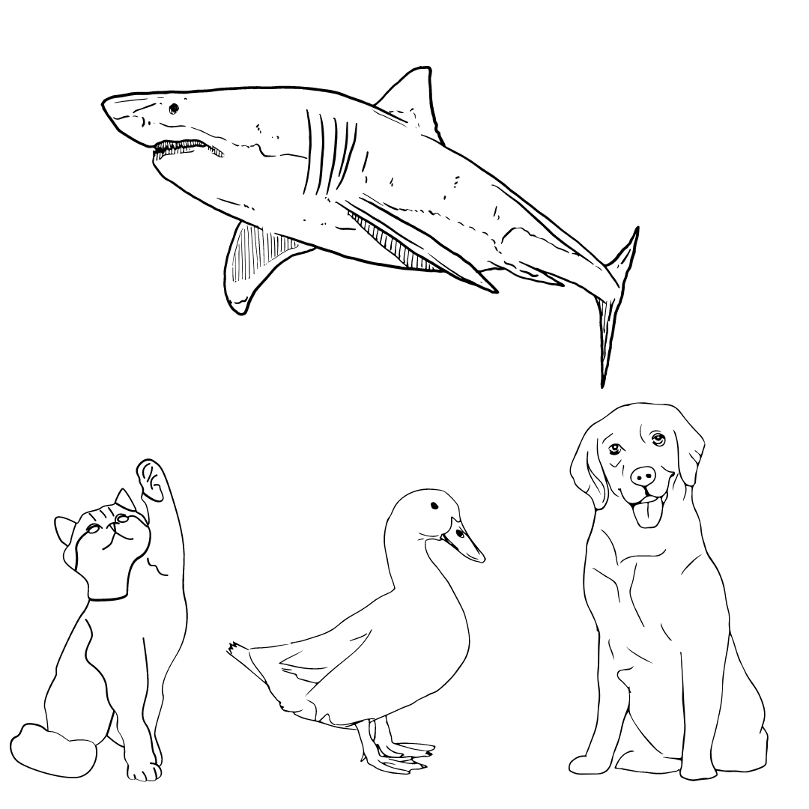

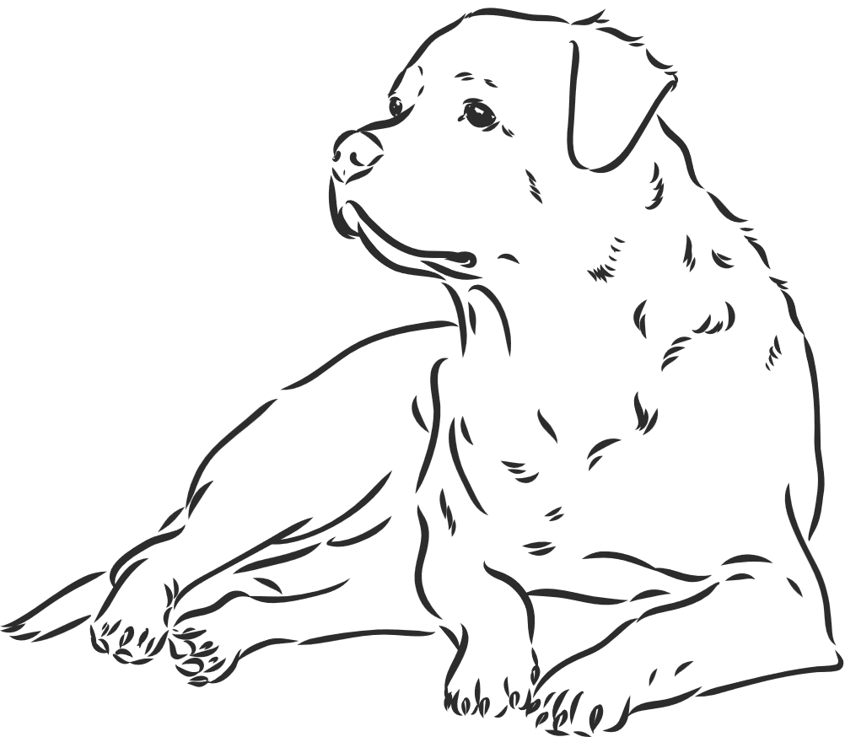

THE COST OF HAVING A PET
Keeping our pets happy healthy and safe throughout their life​

Slide 2



acknowledgement of country
We acknowledge the traditional custodians of the land the ..., on whose land we meet, learn and enjoy today.
We pay our respect to all First Nations People, and value the importance of family, mob and community.

Slide 3
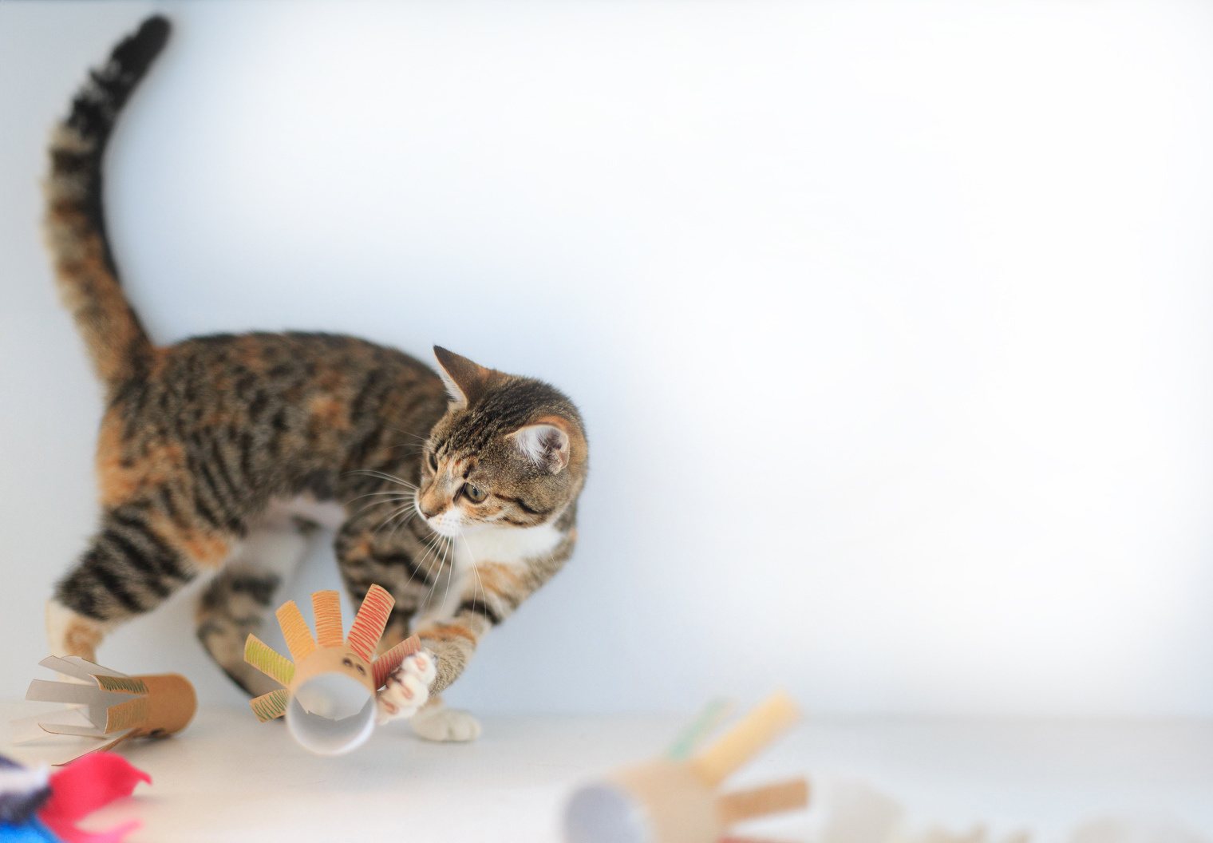

lesson Goals
Learn the different costs of caring for a pet dog and cat​
Understand having a pet means spending money throughout the animals' whole life
Use math to figure out how much money we need to take care of our pets and keep them happy, healthy and safe

Slide 4

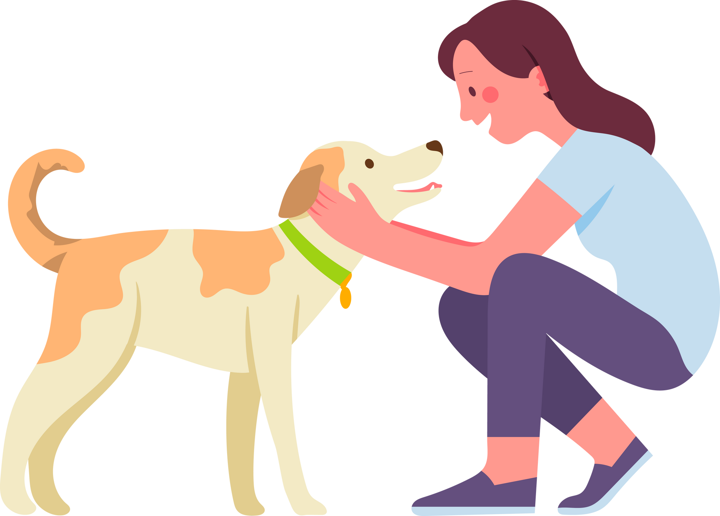

introduction
Having a pet can be one of the most rewarding experiences because they give you companionship and unconditional love
It also means you have big responsibilities! You need to understand and manage the costs to keep your pet happy, healthy, and safe
​

Slide 5




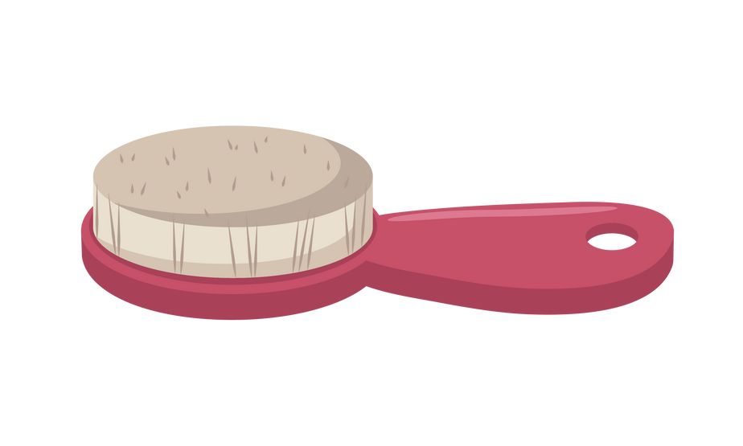
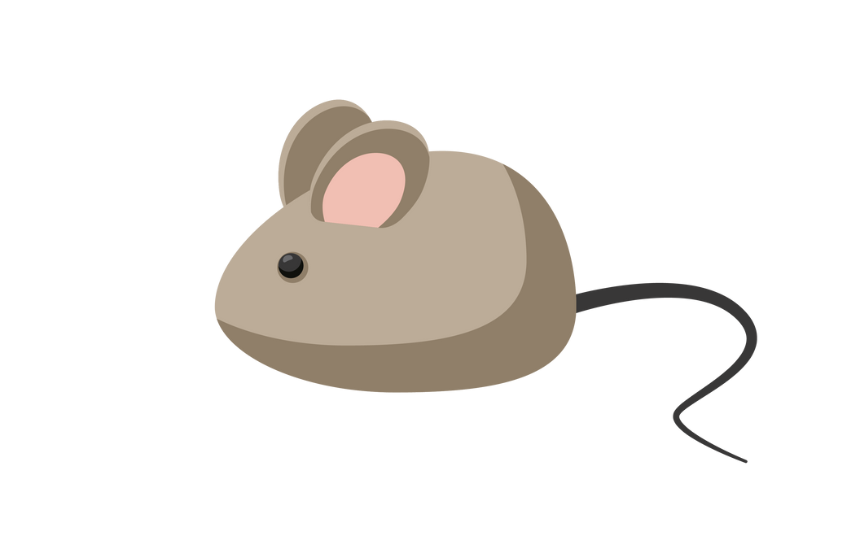


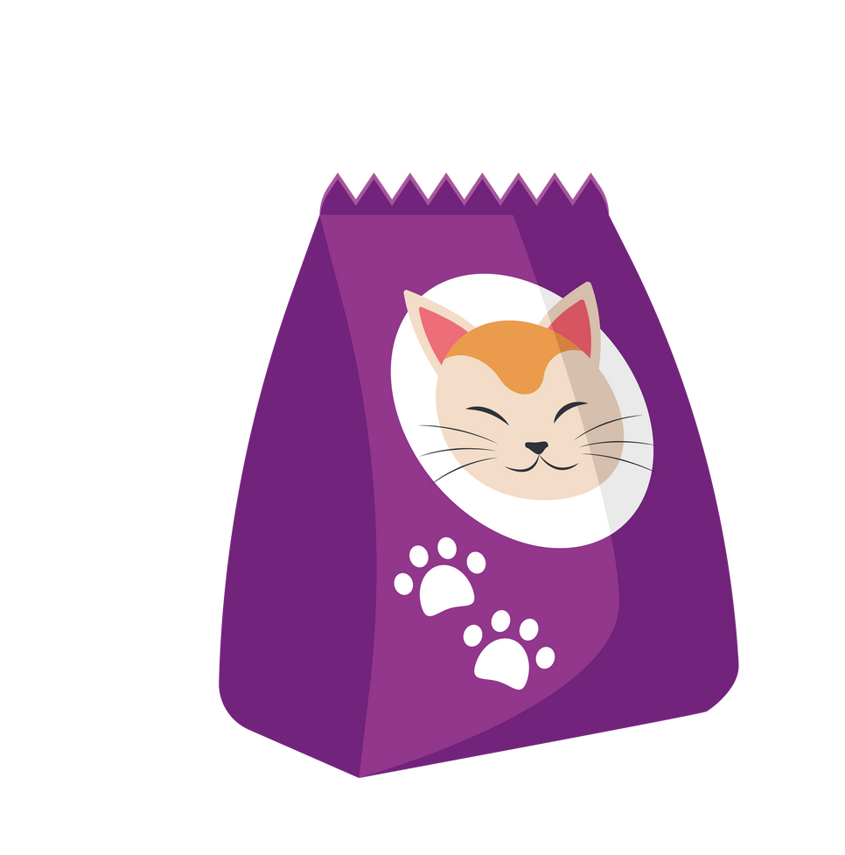
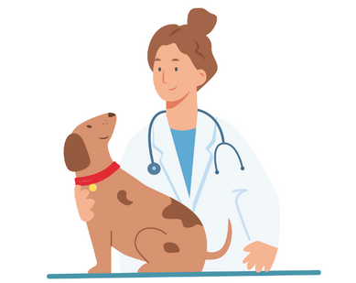



What do our pets need?​

Slide 6



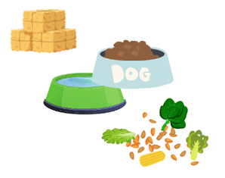
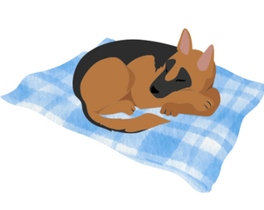
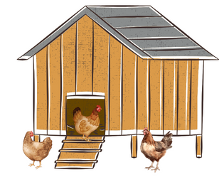
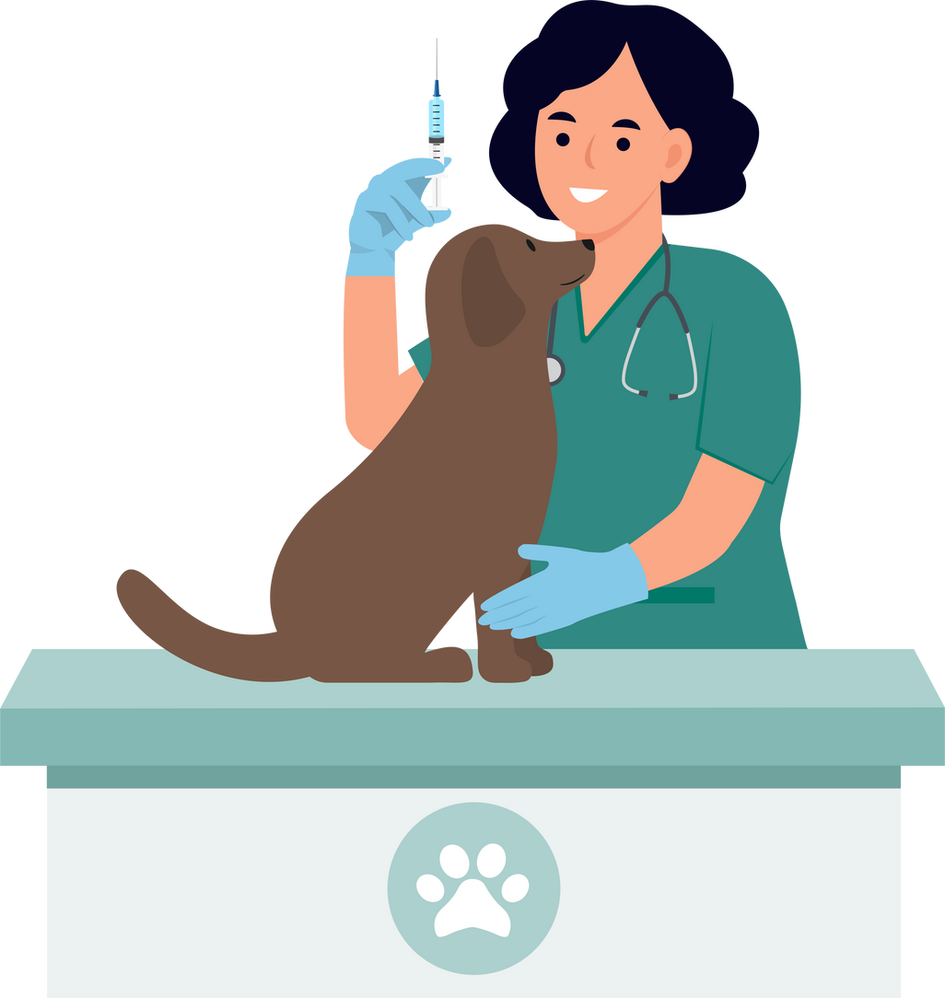
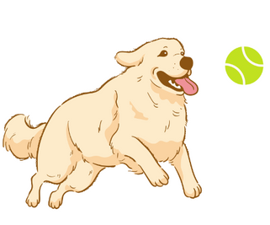


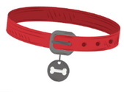


what do our pets need?
Food and Water
Rest
Shelter
Veterinary care
Exercise
and play
Grooming
and hygiene
Collar and id
love
Notes:
Top row: Food and water – Rest – Shelter – Veterinary Care
Bottom row: Exercise + Play – Grooming + Hygiene – Collar and ID – Love
Discuss the main ways we need to care for our pets to ensure they are happy and healthy:
Fresh Food and Water: Discuss the importance of feeding pets the correct diet, with the right foods in the right proportions. Feel free to elaborate with examples from one or more animals. For example, a healthy diet for dogs includes dog food (biscuits or wet food), meat, and raw bones, supplemented with plain rice, eggs, and some fruits and vegetables. You can also provide examples of foods that make dogs sick, such as chocolate, grapes, onions, and cooked bones.F resh water every day. Make sure the bowl is out of the sun and refilled on hot days.
Rest: All animals need a place to rest that is safe, comfortable, warm, and dry. May discuss that this is particularly important for young and senior animals.
Appropriate Shelter: It is our responsibility to ensure that our pets stay safe at home or within our backyard. Animals that may be at risk of injury or death from other animals, such as chickens, need to be securely housed in an enclosure to protect them from predators.
Veterinary Care (including flea and tick treatment): Discuss the importance of taking sick or injured pets to the vet. Mention that vaccinations are a key way to protect pet dogs and cats from diseases that can make them ill.
Exercise and Play: Discuss the importance of physical activity and allowing pets to perform their natural behaviors. Provide examples of different animals’ natural behaviors and how we can exercise and play with them. For example, dogs need walks and time to run around. Dogs also need to sniff and chew things. Providing toys they can chase, and chew will make them happy and help prevent boredom.
Grooming and Hygiene: Discuss the need to clean up after our pets when they go to the toilet and explain why this is important. Pets also need to stay relatively clean, and we may need to help them by giving them a bath. Additionally, some animals require regular brushing or clipping.
Collar and Identification: Explain why it’s important for dogs to wear a collar. You can also explain what microchipping is and how it helps lost animals return to their families.
Love: All animals, whether pets or wildlife, deserve respect. Pets in our care need to be shown love. Provide examples of how we can show love to our pets.

Slide 7
what do our pets need?
Food and Water
Rest
Shelter
Veterinary care
Exercise
and play
Grooming
and hygiene
Collar and id
love
Notes:
Top row: Food and water – Rest – Shelter – Veterinary Care
Bottom row: Exercise + Play – Grooming + Hygiene – Collar and ID – Love
Discuss the main ways we need to care for our pets to ensure they are happy and healthy:
Fresh Food and Water: Discuss the importance of feeding pets the correct diet, with the right foods in the right proportions. Feel free to elaborate with examples from one or more animals. For example, a healthy diet for dogs includes dog food (biscuits or wet food), meat, and raw bones, supplemented with plain rice, eggs, and some fruits and vegetables. You can also provide examples of foods that make dogs sick, such as chocolate, grapes, onions, and cooked bones.F resh water every day. Make sure the bowl is out of the sun and refilled on hot days.

Slide 8
what do our pets need?
Food and Water
Rest
Shelter
Veterinary care
Exercise
and play
Grooming
and hygiene
Collar and id
love
Notes:
Top row: Food and water – Rest – Shelter – Veterinary Care
Bottom row: Exercise + Play – Grooming + Hygiene – Collar and ID – Love
Discuss the main ways we need to care for our pets to ensure they are happy and healthy:
2. Rest: All animals need a place to rest that is safe, comfortable, warm, and dry. May discuss that this is particularly important for young and senior animals.

Slide 9
what do our pets need?
Food and Water
Rest
Shelter
Veterinary care
Exercise
and play
Grooming
and hygiene
Collar and id
love
Notes:
Top row: Food and water – Rest – Shelter – Veterinary Care
Bottom row: Exercise + Play – Grooming + Hygiene – Collar and ID – Love
Discuss the main ways we need to care for our pets to ensure they are happy and healthy:
3. Appropriate Shelter: It is our responsibility to ensure that our pets stay safe at home or within our backyard. Animals that may be at risk of injury or death from other animals, such as chickens, need to be securely housed in an enclosure to protect them from predators. Shelter from weather conditions, not too hot or too cold. In the shade and safe from storms.

Slide 10
what do our pets need?
Food and Water
Rest
Shelter
Veterinary care
Exercise
and play
Grooming
and hygiene
Collar and id
love
Notes:
Top row: Food and water – Rest – Shelter – Veterinary Care
Bottom row: Exercise + Play – Grooming + Hygiene – Collar and ID – Love
Discuss the main ways we need to care for our pets to ensure they are happy and healthy:
4. Veterinary Care (including flea and tick treatment): Discuss the importance of taking sick or injured pets to the vet. Mention that vaccinations are a key way to protect pet dogs and cats from diseases that can make them ill. Need for animals to have a regular check up to prevent them from getting sick.

Slide 11
what do our pets need?
Food and Water
Rest
Shelter
Veterinary care
Exercise
and play
Grooming
and hygiene
Collar and id
love
Notes:
Top row: Food and water – Rest – Shelter – Veterinary Care
Bottom row: Exercise + Play – Grooming + Hygiene – Collar and ID – Love
Discuss the main ways we need to care for our pets to ensure they are happy and healthy:
5. Exercise and Play: Discuss the importance of physical activity and allowing pets to perform their natural behaviors. Provide examples of different animals’ natural behaviors and how we can exercise and play with them. For example, dogs need walks and time to run around. Dogs also need to sniff and chew things. Providing toys they can chase, and chew will make them happy and help prevent boredom.

Slide 12
what do our pets need?
Food and Water
Rest
Shelter
Veterinary care
Exercise
and play
Grooming
and hygiene
Collar and id
love
Notes:
Top row: Food and water – Rest – Shelter – Veterinary Care
Bottom row: Exercise + Play – Grooming + Hygiene – Collar and ID – Love
Discuss the main ways we need to care for our pets to ensure they are happy and healthy:
6. Grooming and Hygiene: Discuss the need to clean up after our pets when they go to the toilet and explain why this is important. Pets also need to stay relatively clean, and we may need to help them by giving them a bath. Additionally, some animals require regular brushing or clipping.

Slide 13
what do our pets need?
Food and Water
Rest
Shelter
Veterinary care
Exercise
and play
Grooming
and hygiene
Collar and id
love
Notes:
Top row: Food and water – Rest – Shelter – Veterinary Care
Bottom row: Exercise + Play – Grooming + Hygiene – Collar and ID – Love
Discuss the main ways we need to care for our pets to ensure they are happy and healthy:
7. Collar and Identification: Explain why it’s important for dogs to wear a collar. You can also explain what microchipping is and how it helps lost animals return to their families.

Slide 14
what do our pets need?
Food and Water
Rest
Shelter
Veterinary care
Exercise
and play
Grooming
and hygiene
Collar and id
love
Notes:
Top row: Food and water – Rest – Shelter – Veterinary Care
Bottom row: Exercise + Play – Grooming + Hygiene – Collar and ID – Love
Discuss the main ways we need to care for our pets to ensure they are happy and healthy:
8. Love: All animals, whether pets or wildlife, deserve respect. Pets in our care need to be shown love. Provide examples of how we can show love to our pets.

Slide 15
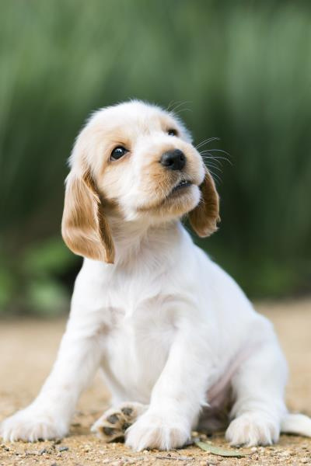
cost of having a pet
In addition to the cost of adopting or buying your pet, there’s a long list of expenses involved in keeping your pet healthy, happy and safe throughout their lives
You’ll need consider these expenses before deciding which pet is the right one for you
The cost of dog ownership is generally greater than a cat

Slide 16


Shopping list for a…​
Comfortable bed​
Safety collar and bell​
Food bowl​
Water bowl​
Worming treatments​
Flea treatments ​
Vaccinations
Scratching post ​
Litter tray ​and scoop
Cat litter ​
Grooming brush ​
Carrier​

Slide 17
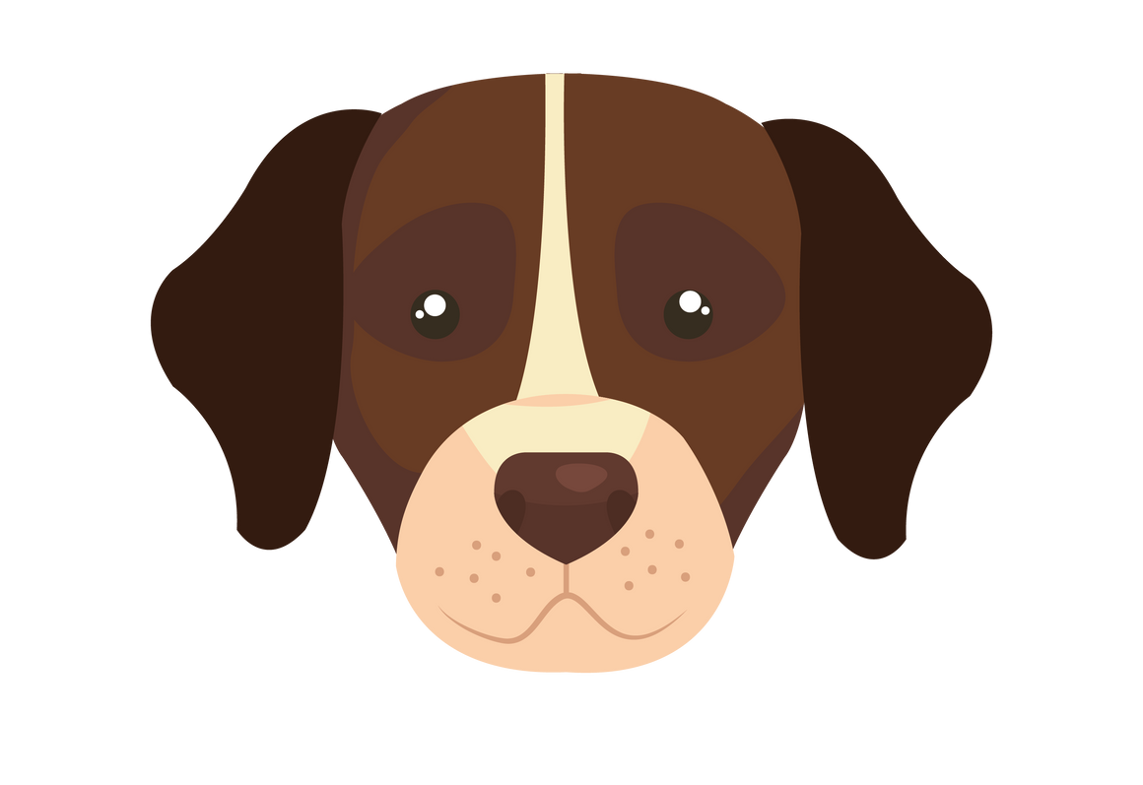
Shopping list for a…​
Comfortable bed​
Safe dog collar and identification tag​
Food bowl​
Water bowl​
Worming treatments​
Flea treatments
Vaccinations​
Kennel​
Lead​
Animal safe shampoo​

Slide 18


Find the right pet for you​
Learn about different needs of the animal before choosing it as a pet ​
Think about how much space your pet will have in your home and backyard
Adopt don’t shop ​
I need haircuts to look this good!

Slide 19
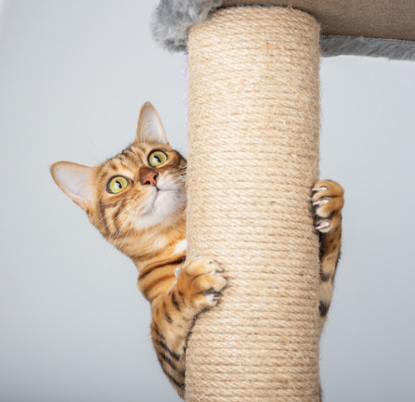
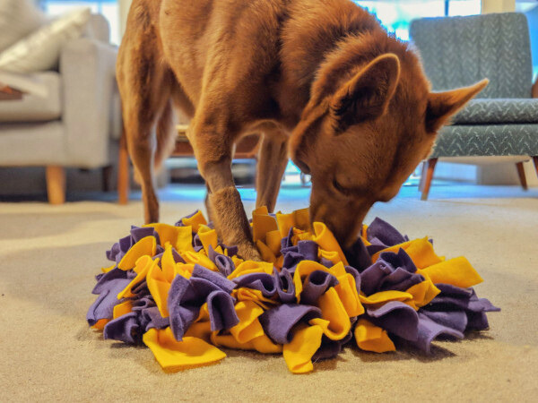
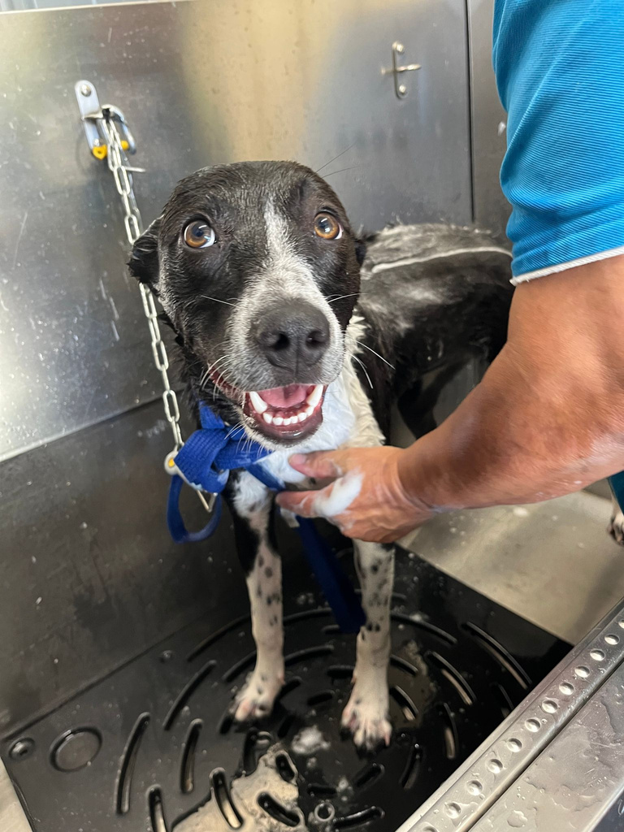
Money saving tips
Keep your pets healthy with regular exercise and a good diet
Make your own
toys and treats
Learn to wash
your dog and trim
their nails yourself
Buy in bulk, on sale or second hand

Slide 20




maths worksheets
Round
it up!
Number
line
Change
from $20
Extension
Tasks

Slide 21
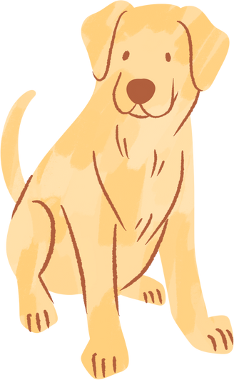

reflection
Before getting a pet, what is the first thing you think you should do?
Will all dogs cost the same amount of money to care for? Justify your answer
Will all cats cost the same amount of money to care for? Justify your answer
Why is it important to think about how much time and money a pet needs before getting one?

Slide 22


Slide 23
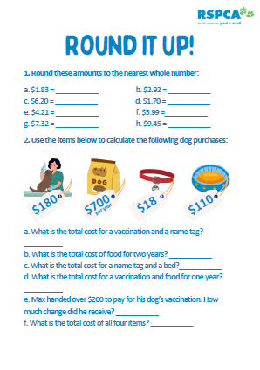
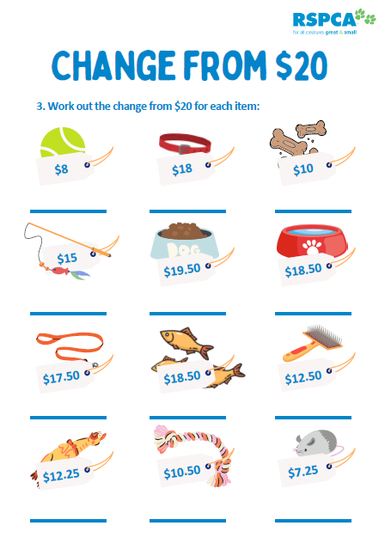
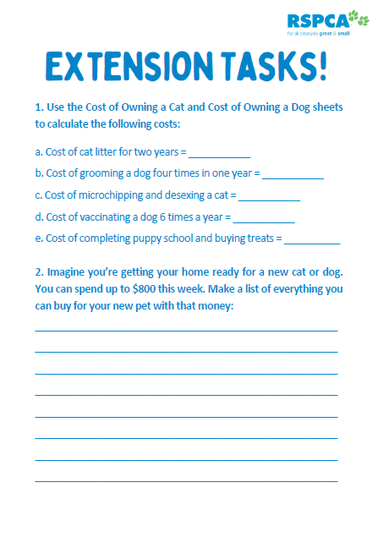
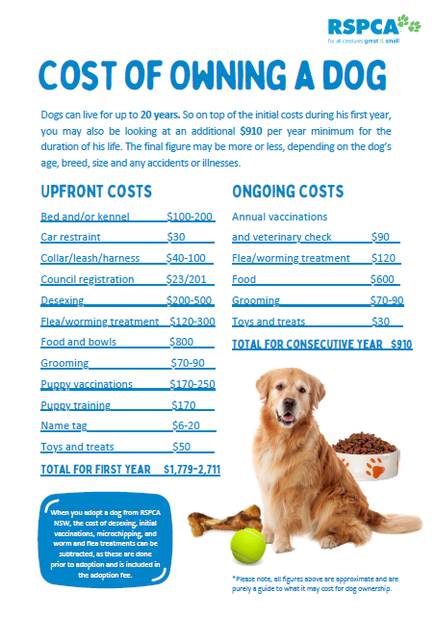
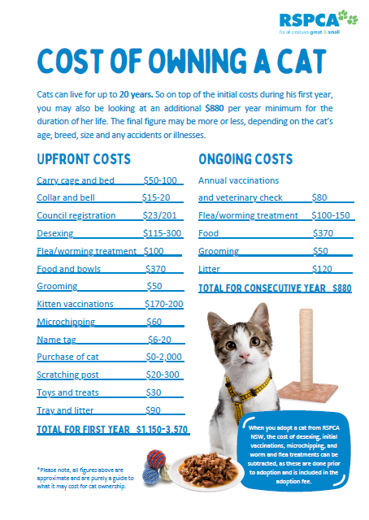
Lesson resources
worksheets
hand outs

